Slide 1
Mixed Martial Arts (MMA)
Louis

Slide 2
What is it?

Slide 3
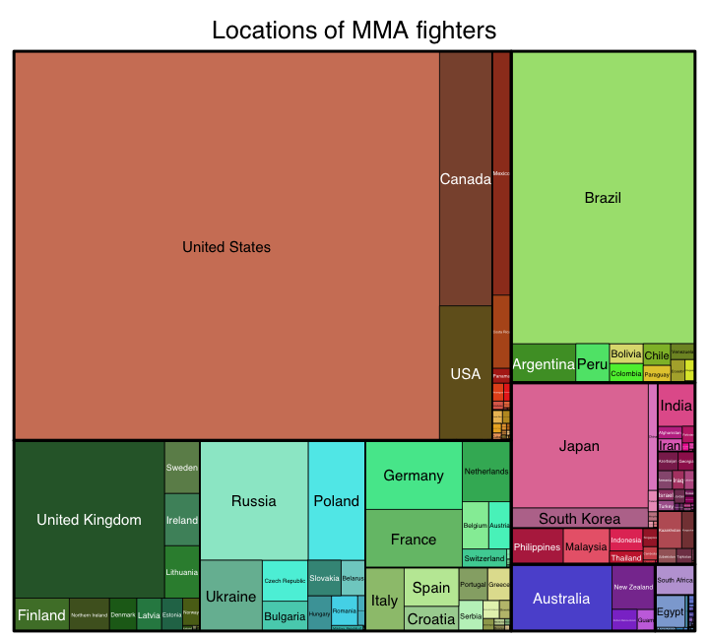
What is it?

Slide 4
Major Players
UFC (+Pride, WEC, Strikeforce)
Bellator MMA
ONE championship
World series of fighting
Invicta fc
Rizin fighting federation
Etc...

Slide 5
What is it?

Slide 6
Data
Data on MMA fighters/Fights not readily available
The sport is still in its Infancy
Many leagues of different sizes with different rules
http://www.fightmetric.com/
…Started in 2007, FightMetric® is the world’s only comprehensive mixed martial arts statistics and analysis provider, and is the official statistics provider of the UFC®…
http://www.sherdog.com/
Sherdog is an American website devoted to the sport of mixed martial arts. The site is a member of the Crave Online network and provides MMA related content for ESPN.com.

Slide 7
Data Investigation
Details about the fight | FIGHT ORDER
 | KEY
 | ROUND FORMAT
 | EVENT_TYPE
 | EVENT_NAME
 | EVENT_YEAR
 | EVENT_MONTH
 | EVENT_DAY
 | LOCATION COUNTRY
 | LOCATION CITY
 | VENUE
 | ATTENDANCE
 | MAIN FIGHT
 | MID
 | WEIGHT CLASS
 | REF
Win Details | OUTCOME
 | METHOD
 | METHOD_D
 | ROUND
 | FINISH_ROUND_MIN
 | FINISH_ROUND_SEC
 | FINISH_ROUND_INSECONDS
 | TOTAL_INSECONDS
 | STR
 | TD
 | SUB
 | PASS
Fighter Details | FIGHTER NAME
 | FIGHER NO
 | FIGHTER ID
 | NICK
 | ASSOCIATION
 | LOCALITY
 | COUNTRY
 | BIRTH_YEAR
 | AGE_AT_FIGHT
 | HEIGHT_CM
 | WEIGHT_KG
 | REACH_INCH
 | REACH_INCH1
 | STANCE
 | WIN_AT_FIGHT
 | NOTWIN_AT_FIGHT
 | TOTAL_AT_FIGHT
 | WINRATIO_AT_FIGHT
 | STRAVG_AT_FIGHT
 | TDAVG_AT_FIGHT
 | SUBAVG_AT_FIGHT
 | PASSAVG_AT_FIGHT
 | AGE_DIFF

Slide 8
Data Investigation
...Example...

Slide 9
Scatterplots

Slide 10
Scatterplots

Slide 11
Data investigation
Fights occur in weight classes and are meant to be “fair”
We are trying to predict when you enter the cage vs. an opponent, what are your chances of winning?
A fighter’s attributes vs. his opponent might be more suitable…
Difference between fighter and his opponent | HEIGHT_DIFF
 | WEIGHT_DIFF
 | REACH_DIFF
 | EXP_DIFF
 | STRAVG_AT_FIGHT_DIFF
 | TDAVG_AT_FIGHT_DIFF
 | SUBAVG_AT_FIGHT_DIFF
 | PASSAVG_AT_FIGHT_DIFF
 | WINRATIO_DIFF
 | STANCE_DIFF
 | REACH_DIFF1

Slide 12
Business problem
Based on a fighter’s attributes vs. his opponent’s, can we determine whether he would be victorious (i.e. what are his chances of winning)?
IF we assume a fighter is victorious, can we predict how he might win, based on his attributes, his opponents’ attributes and other factors?

Slide 13
Win/Loss Model
Fights are banded into three categories:
Light: Flyweight, bantamweight, featherweight (52.2 kg - 65.8kg)
Middle: Lightweight, Welterweight (65.8kb – 77.1 kg)
Heavy: Middleweight, light heavyweight, heavyweight (77.1kg - 120.2kg)
Logistic Regression/Decision Tree/Random Forests
Predicts WIN =1, NOT WIN = 0 Outcome
Using “Difference” Variables
E.g. if the figher is 185cm and your opponent is 180cm, the difference variable for height is +5
E.g. if the fighter is 70kg and your opponent is 76kg, the difference variable for weight is -6

Slide 14
Win/Loss Model - Insights
The heavier you are in the ”light” classes the better – but other classes not so much ⬅ maybe it is due to the “proportion of weight”
Experience counts for less than I thought…but experience in WINNING helps!!!
”Fight stat” variables should be positively correlated with “win”, BUT the “submission per fight” variable was negatively correlated with wins. Is it because when you fail a submission, it turns out really bad foryou....?
Reach does help!!! (but the effect is more prominent the heavier class you are in...once again, could it be a proportion effect?)

Slide 15
Win Type Model
Fights are banded into three categories:
Light: Flyweight, bantamweight, featherweight (52.2 kg - 65.8kg)
Middle: Lightweight, Welterweight (65.8kb – 77.1 kg)
Heavy: Middleweight, light heavyweight, heavyweight (77.1kg - 120.2kg)
Multinomial Logistic Regression / Decision tree
Given a fighter Wins, PREDICT How he will win
Predicts Win by Decision = 0, Win by TKO/KO = 1, Win by Submission = 2
Using more variables, both absolute and difference variables

Slide 16
Win Type Model - Insights
The younger the fighter, the more likely you are to win by KO/TKO/Submission – older/more experienced fighters play the patience game better?
Some expected trends:
The more strikes per fight you throw, more likely to KO/TKO (but more prominent in light classes only…)
The more submissions/takedowns you execute, more likely to submit (all classes…meaning everyone should learn BJJ/Sambo/Wrestling)
Southpaw – the benefit is less pronouced than I thought
The more “important” the fight (e.g. It is the main fight of the day, the fighters are more likely to KO/TKO/Submit an opponent)

Slide 17
Application
JJ vs DC (upcoming fights)
CM vs ND (different division)

Slide 18
Win/Loss model
Why is the accuracy so low?
Is my model no good?
Is my data no good?
Structural changes in my Data?
Decision wins are now more common, meaning fights are lasting the full 3 or 5 rounds
Does this mean fights have been set to be “more Fair”?
This needs more investigation!

Slide 19
Win/Loss model
ALL data (1999 – 2016)
1999-2009 only
2010 onwards only
Middle Model
Heavy Model

Slide 20
Limitation and Future Enhancements
Data – not enough…yet...
Other brands and organisations
Other variables (e.g. Type of training a fighter has had, coach, etc...)
Should have done difference %, not absolute difference...
Linking the two models together
Problem with Stance
Problem with duration of the fight/round
A few others....
More granular segmentation (e.g. Womens’ divisions)
Structural Changes!!!
Odds Data – how does this model/result line up with odd makers
More Modelling!!!!

Slide 21
What did I Learn/Achieve & Going Forward
There is so much I want to learn because there is so much I don’t know…
Data scrapping. Modelling is fun but data integrity and sourcing is so important...
Played around with BeautifulSoup, scrapping data off Sherdog.com

Slide 22
Question?

Slide 23
Appendix
Appendix

Slide 24
Win/NoT WIN Model
Based on a fighter’s attributes vs. his opponent’s, can we determine whether he would be victorious (i.e. what are his chances of winning)?

Slide 25
Win TYPE Model
IF we assume a fighter is victorious, can we predict how he might win, based on his attributes, his opponents’ attributes and other factors?

Slide 26
Win TYPE Model
IF we assume a fighter is victorious, can we predict how he might win, based on his attributes, his opponents’ attributes and other factors?

